Slide 1
New and Old Book Purchase System(Book Wala)
2110030031- Sumeet Sharma
2110030190- K. Sai Vardhan Reddy
2110030252- Mohammed Afeef Sayeed
2110030109- D. Harshavardhan Reddy
Under the guidance of
Mrs. Madhu Priya

Slide 2
Review 2

Slide 3
Objective
The Main Objective of this project is to create an Online Book Shop That Allows user that allows to search and purchase a book online based category, author and subject.
(Based on Bookstore Management System)

Slide 4
What is Bookstore Management System?
Bookstore management system mainly focuses on the activities of a book store such as information on books and books sold to customers.
The database flexibility, convenient features, the maximum increase in customer service, access to accurate information make this ideal for all sizes of book stores.

Slide 5
Data Set Collections
User Table :
User{u_ID,u_Name,u_Username,u_Password,u_gender,u_email,u_contact,u_city}
Contact Table :
Contact{con_id, con_name, con_email, con_query}
Book Table :
Book{Book_ID, Book_Name, Book_desc, Book_Publisher, Book_Price, Book_NoPages, Book_Img}

Slide 6
Cart Table :
Cart{Cart_ID,Book_ID,User_Name,Cost,Book_Name,Quantity}
Checkout Table :
CheckOut(Order_ID,Cart_ID,Order_Date,Total_Amount}

Slide 7
Proposed System
It is the Automated Book Store Management System. Our Software user can add members, add books , search members, search books, update info, etc…
It provides “BETTER AND EFFICENT” services to members
Reduced The Workload for the Employees
Faster Access to the Information.
All details will be available in one click

Slide 8
Our Idea to Implement :
To Add Rent a Book option
Pay on Delivery Option
Giving Opportunities To the New Publishers.

Slide 9
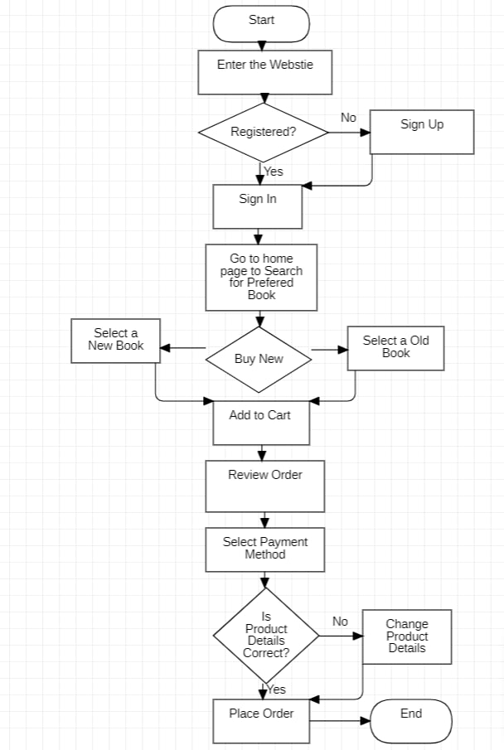
Flow chart :

Slide 10
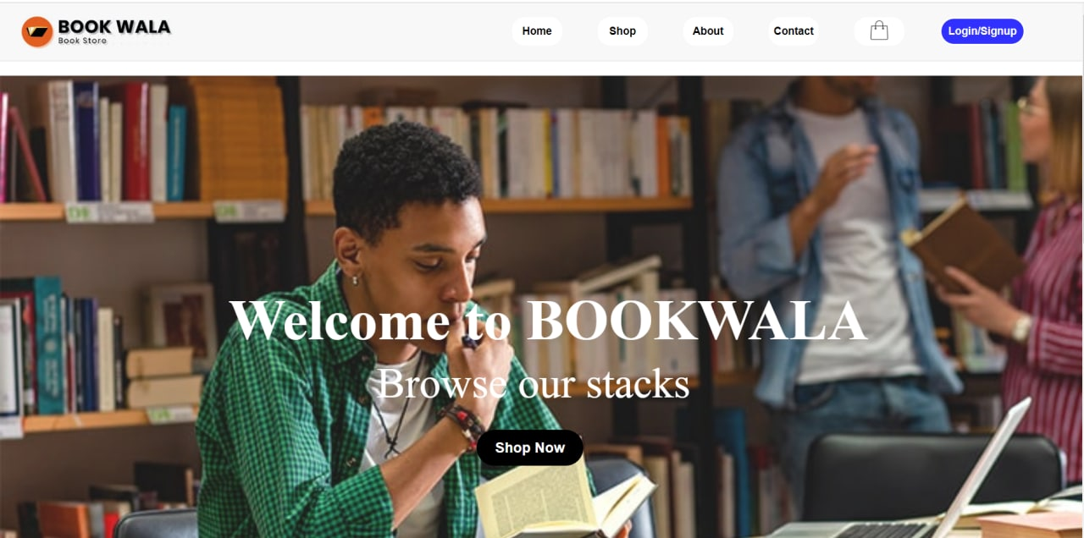
Work in progress
Home Page

Slide 11
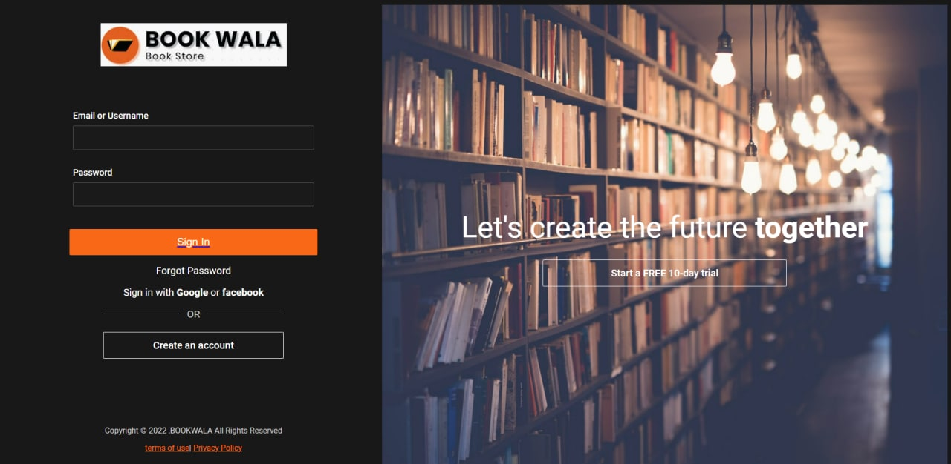
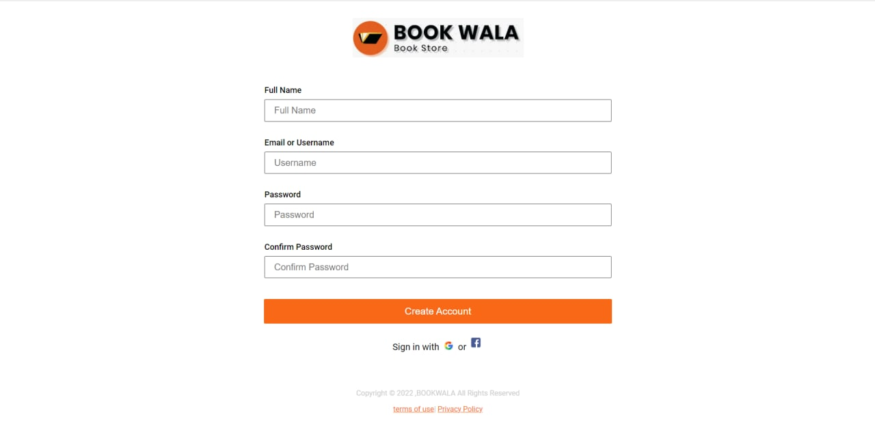
Login Page
Sign up Page

Slide 12
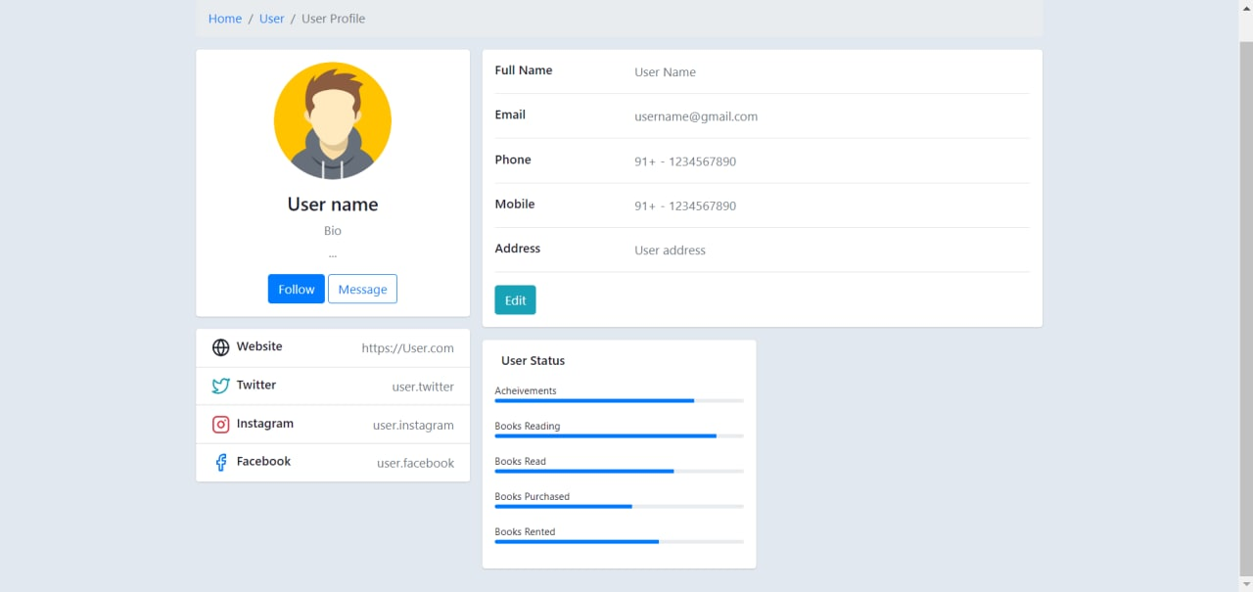
User Profile :

Slide 13

TOOLS SETUP
Python
Django
HTML
CSS
JavaScript

Slide 14
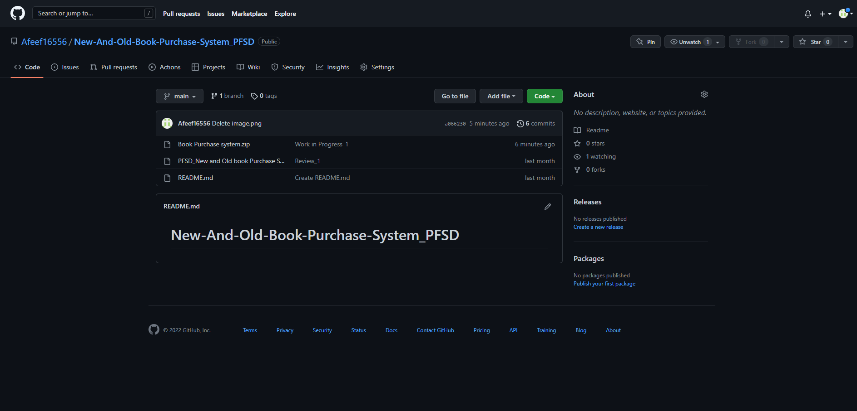

Github setup
https://github.com/Afeef16556/New-And-Old-Book-Purchase-System_PFSD

Slide 15
Thank you

